Slide 1
CPU Scheduling
Basic Concepts
Scheduling Criteria
Scheduling Algorithms
Operating System Concepts

Slide 2
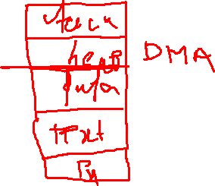
Process Concept
Process – a program in execution.
An instance of a program running on a computer.
The entity that can be assigned to and executed on a processor.
A process needs certain resources, including CPU time, memory, files, and I/O devices, to accomplish its task.
A process includes:
  program counter
  stack
  data section
Operating System Concepts

Slide 3
Main OS Process-related Goals
Allocate resources to processes
Interleave the execution of existing processes to maximize processor utilization
Provide reasonable response times
Support inter-process communication (and synchronization) and user creation of processes
Operating System Concepts

Slide 4
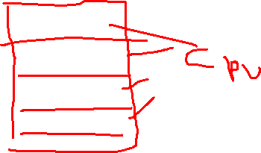
How are these goals achieved?
Schedule and dispatch processes for execution by the processor
Implement a safe and fair policy for resource
allocation to processes
Respond to requests by user programs
Construct and maintain tables for each process managed by the operating system

Slide 5
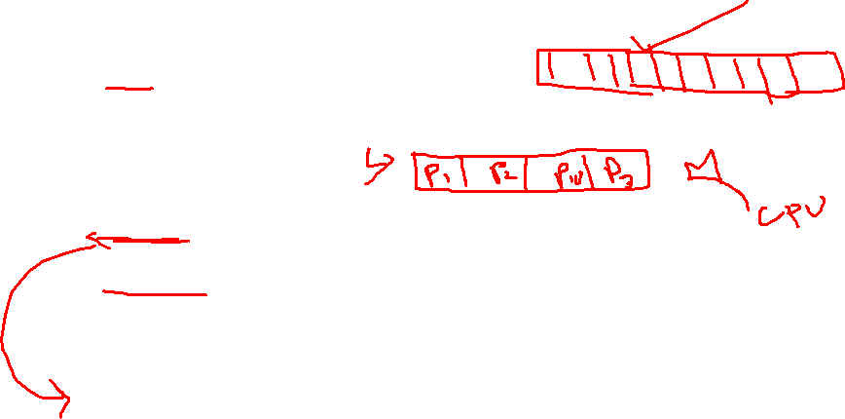
Process State
As a process executes, it changes state
  new: The process is being created.
  ready: The process is waiting to be assigned to a process.
  running: Instructions are being executed.
  waiting: The process is waiting for some event to occur.
  terminated: The process has finished execution.
Operating System Concepts

Slide 6
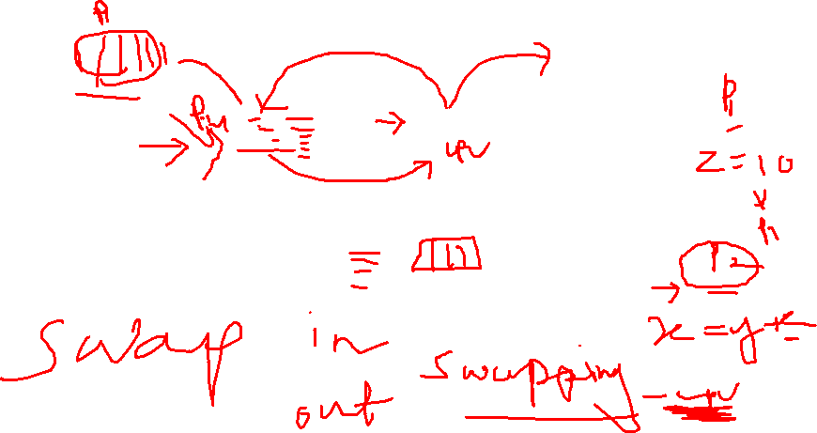

Diagram of Process State
Operating System Concepts

Slide 7

Process Scheduling Queues
Job queue – set of all processes in the system.
Ready queue – set of all processes residing in main memory, ready and waiting to execute.
Device queues – set of processes waiting for an I/O device.
Process migration between the various queues.
Operating System Concepts

Slide 8
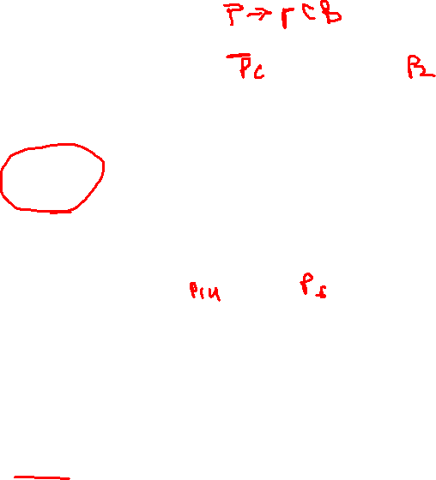

Ready Queue And Various I/O Device Queues
Operating System Concepts

Slide 9
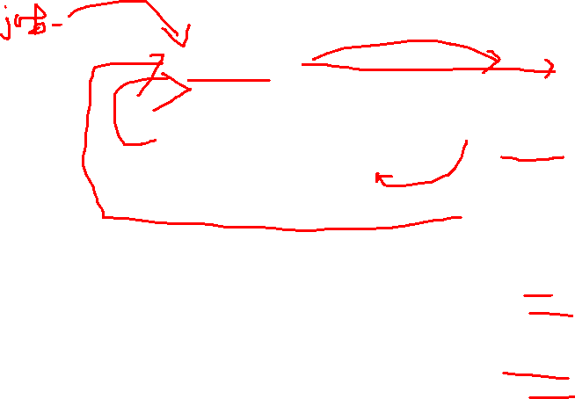

Representation of Process Scheduling
Operating System Concepts

Slide 10

Process Control Block (PCB)
Information associated with each process.
Process state
Program counter
CPU registers
CPU scheduling information
Memory-management information
Accounting information
I/O status information
Operating System Concepts

Slide 11

Process Control Block (PCB)
Operating System Concepts

Slide 12



CPU Switch From Process to Process
Operating System Concepts

Slide 13

Context Switch
When CPU switches to another process, the system must save the state of the old process and load the saved state for the new process.
Context-switch time is overhead; the system does no useful work while switching.
Time dependent on hardware support.
Operating System Concepts

Slide 14
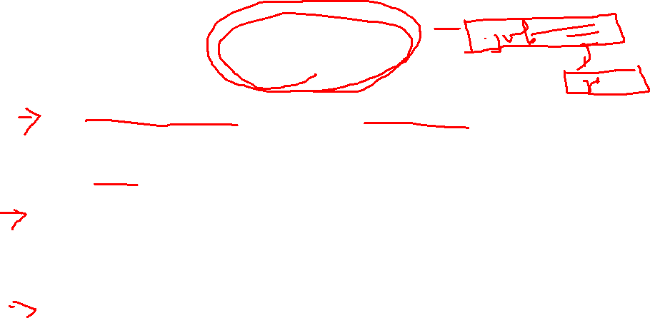
Schedulers
Long-term scheduler (or job scheduler) – selects which processes should be brought into the ready queue.
Short-term scheduler (or CPU scheduler) – selects which process should be executed next and allocates CPU.
Medium–term scheduler- responsible for swapping of processes in and out of the memory.
Operating System Concepts

Slide 15
Schedulers (Cont.)
Short-term scheduler is invoked very frequently (milliseconds) ⇒ (must be fast).
Long-term scheduler is invoked very infrequently (seconds, minutes) ⇒ (may be slow).
The long-term scheduler controls the degree of multiprogramming.
Processes can be described as either:
  I/O-bound process – spends more time doing I/O than computations, many short CPU bursts.
  CPU-bound process – spends more time doing computations; few very long CPU bursts.
Operating System Concepts

Slide 16

Basic Concepts
Maximum CPU utilization obtained with multiprogramming
CPU–I/O Burst Cycle – Process execution consists of a cycle of CPU execution and I/O wait.
CPU burst distribution
Operating System Concepts

Slide 17


Alternating Sequence of CPU And I/O Bursts
Operating System Concepts

Slide 18
CPU Scheduler
Selects from among the processes in memory that are ready to execute, and allocates the CPU to one of them.
CPU scheduling decisions may take place when a process:
  1. Switches from running to waiting state.
  2. Switches from running to ready state.
  3. Switches from waiting to ready.
  4. Terminates.
Scheduling under 1 and 4 is nonpreemptive.
All other scheduling is preemptive.
Operating System Concepts

Slide 19
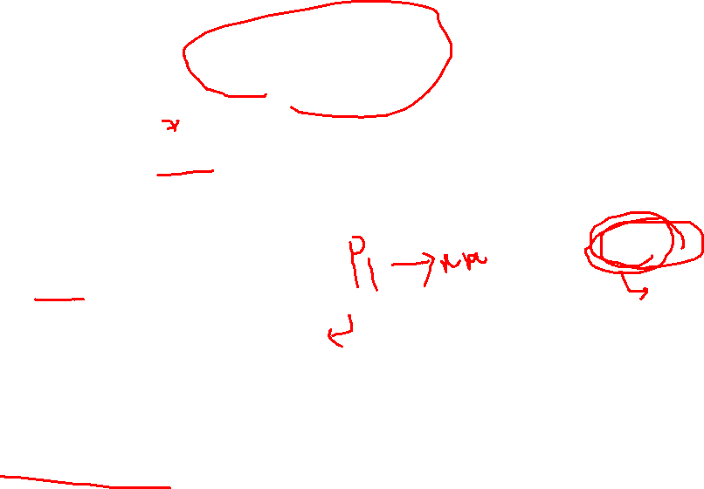
Dispatcher
Dispatcher module gives control of the CPU to the process selected by the short-term scheduler; this involves:
  switching context
  switching to user mode
  jumping to the proper location in the user program to restart that program
Dispatch latency – time it takes for the dispatcher to stop one process and start another running.
Operating System Concepts

Slide 20

Scheduling Criteria
CPU utilization – keep the CPU as busy as possible
Throughput – # of processes that complete their execution per time unit
Turnaround time – amount of time to execute a particular process
Waiting time – amount of time a process has been waiting in the ready queue
Response time – amount of time it takes from when a request was submitted until the first response is produced.
Operating System Concepts

Slide 21

Optimization Criteria
Max CPU utilization
Max throughput
Min turnaround time
Min waiting time
Min response time
Operating System Concepts

Slide 22
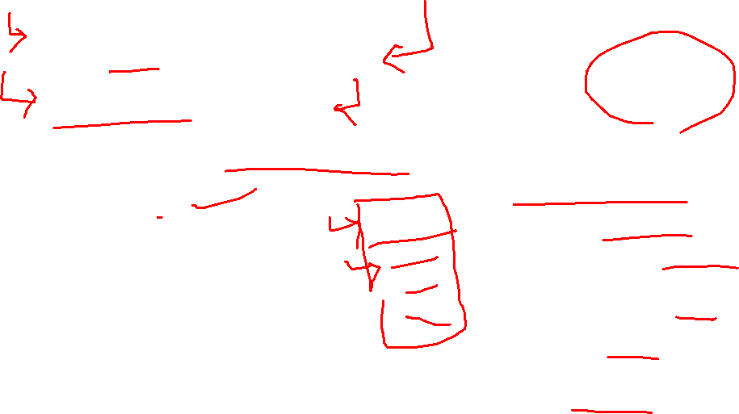
Scheduling Algorithms
First Come First serve
Shortest job First
Shortest Remaining Time Next
Priority
Round Robin
Multi level Queue
Multi level Feedback Queue
Operating System Concepts

Slide 23
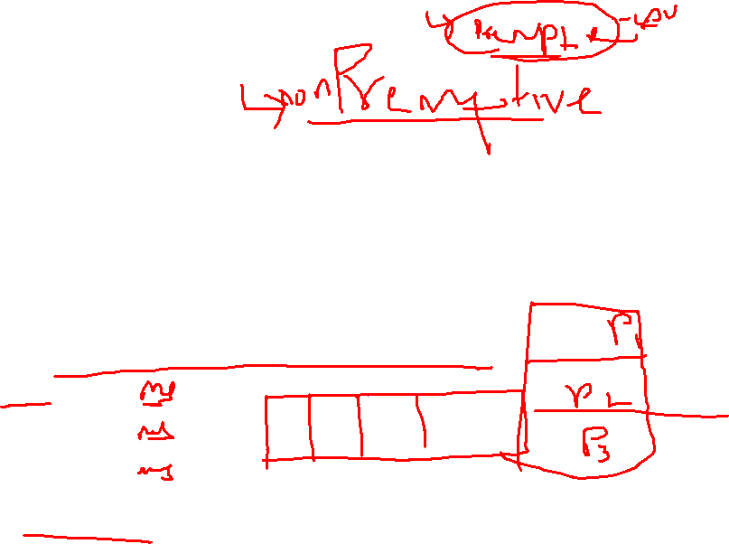
Scheduling Algorithms: First-Come, First-Served (FCFS)
“Run until Done:” FIFO algorithm
In the beginning, this meant one program runs non-preemtively until it is finished (including any blocking for I/O operations)
Now, FCFS means that a process keeps the CPU until one or more threads block
Example: Three processes arrive in order P1, P2, P3.
  P1 burst time: 24
  P2 burst time: 3
  P3 burst time: 3
Draw the Gantt Chart and compute Average Waiting Time and Average Completion Time.
Lec 3
Operating Systems

Slide 24
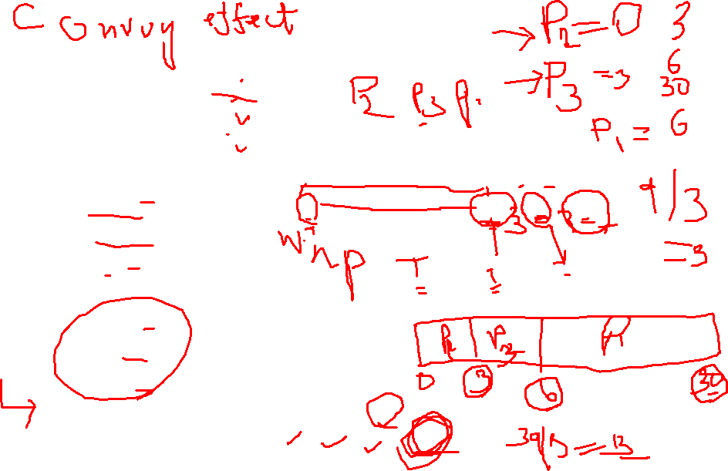
Scheduling Algorithms: First-Come, First-Served (FCFS)
Example: Three processes arrive in order P1, P2, P3.
  P1 burst time: 24
  P2 burst time: 3
  P3 burst time: 3
Waiting Time
  P1: 0
  P2: 24
  P3: 27
Completion Time:
  P1: 24
  P2: 27
  P3: 30
Average Waiting Time: (0+24+27)/3 = 17
Average Completion Time: (24+27+30)/3 = 27
P1
P2
P3
0
24
27
30
Lec 3
Operating Systems

Slide 25
Scheduling Algorithms: First-Come, First-Served (FCFS)
What if their order had been P2, P3, P1?
  P1 burst time: 24
  P2 burst time: 3
  P3 burst time: 3
Lec 3
Operating Systems

Slide 26
First-Come, First-Served (FCFS)
What if their order had been P2, P3, P1?
  P1 burst time: 24
  P2 burst time: 3
  P3 burst time: 3
Waiting Time
  P1: 0
  P2: 3
  P3: 6
  Completion Time:
  P1: 3
  P2: 6
  P3: 30
Average Waiting Time: (0+3+6)/3 = 3 (compared to 17)
Average Completion Time: (3+6+30)/3 = 13 (compared to 27)
P2
P3
P1
0
3
6
30
Lec 3
Operating Systems

Slide 27
Shortest-Job-First (SJR) Scheduling
Associate with each process the length of its next CPU burst. Use these lengths to schedule the process with the shortest time.
Two schemes:
  nonpreemptive – once CPU given to the process it cannot be preempted until completes its CPU burst.
  preemptive – if a new process arrives with CPU burst length less than remaining time of current executing process, preempt. This scheme is know as the
  Shortest-Remaining-Time-First (SRTF).
SJF is optimal – gives minimum average waiting time for a given set of processes.
Operating System Concepts

Slide 28
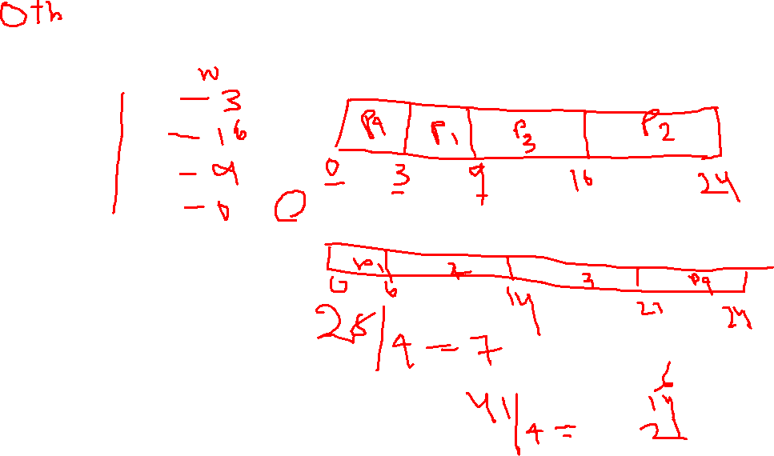
Example of Non-Preemptive SJF
Processes Burst Time
P₁ 6
P₂ ₈
P₃ 7
P₄ 3
SJF (non-preemptive)
Average waiting time =
Operating System Concepts

Slide 29
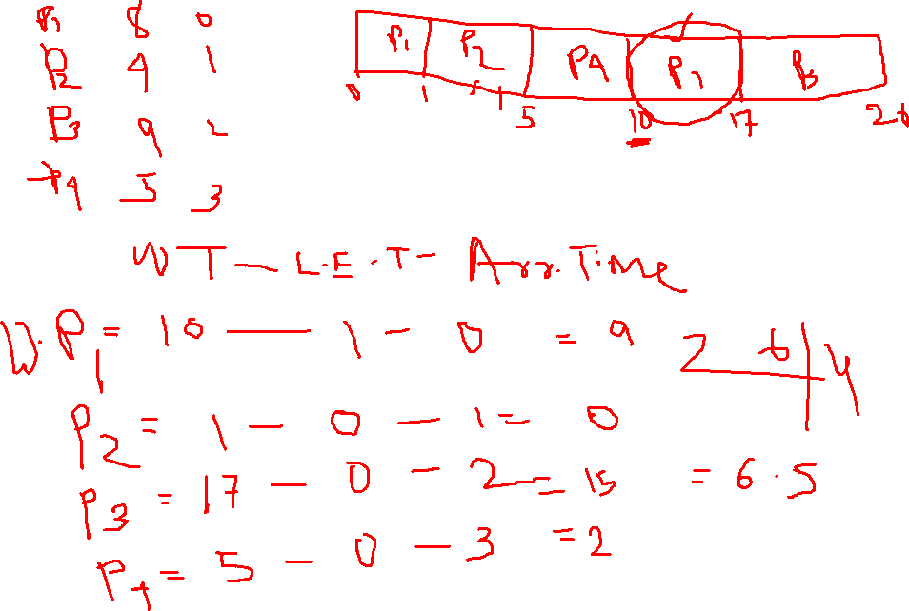
Operating System Concepts

Slide 30
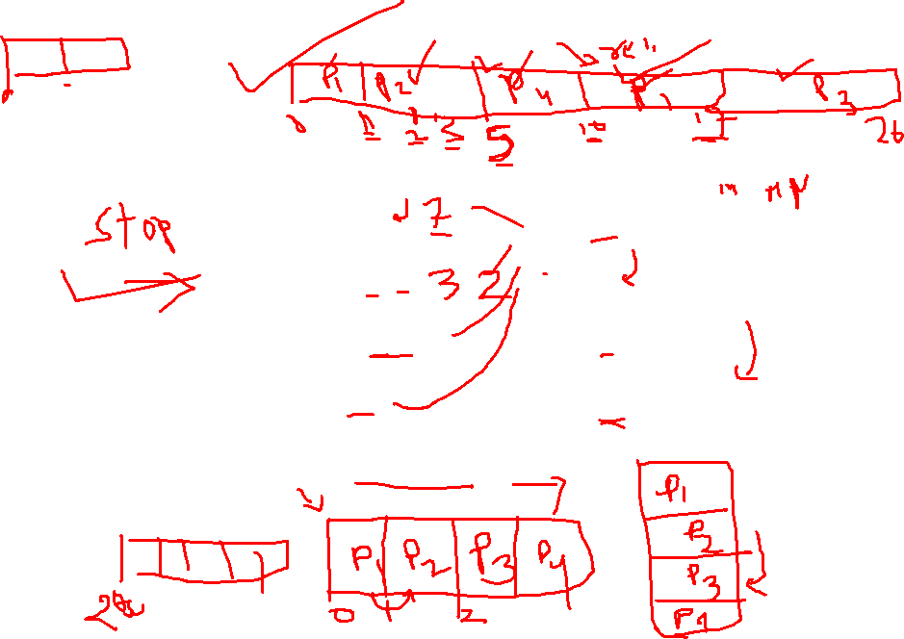
Example of SJF (preemptive)
Processes Burst Time Arrival Time
P₁ 8 0
P₂ 4 1
P₃ 9 2
P₄ 5 3
Average waiting time =
Operating System Concepts

Slide 31
Example of SJF
Process Arrival Time Burst Time
P₁ 0.0 7
P₂ 2.0 4
P₃ 4.0 1
P₄ 5.0 4
Operating System Concepts

Slide 32
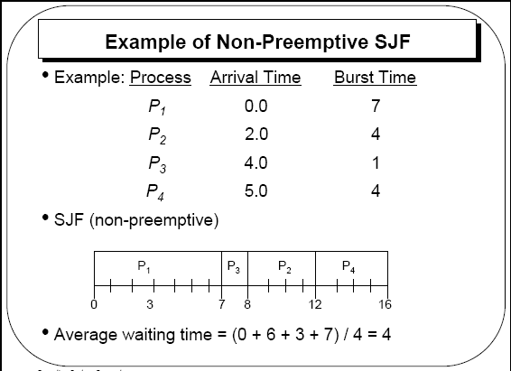
Operating System Concepts

Slide 33
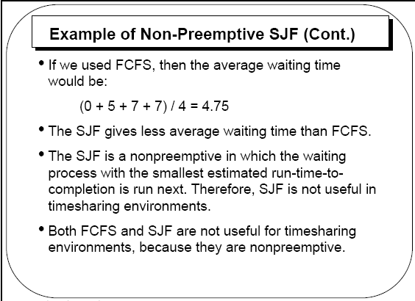
Operating System Concepts

Slide 34
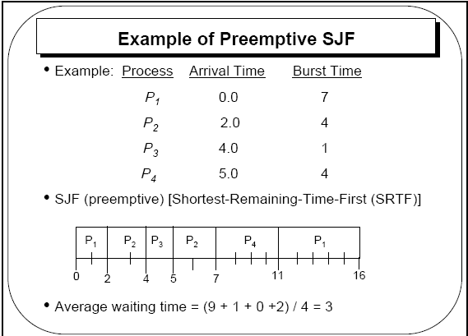
Operating System Concepts

Slide 35
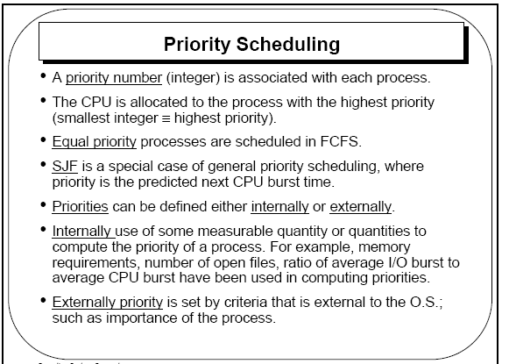
Operating System Concepts

Slide 36
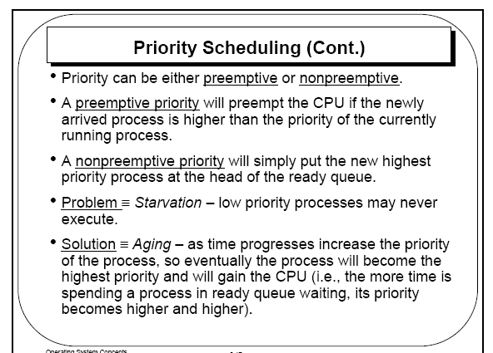
Operating System Concepts

Slide 37
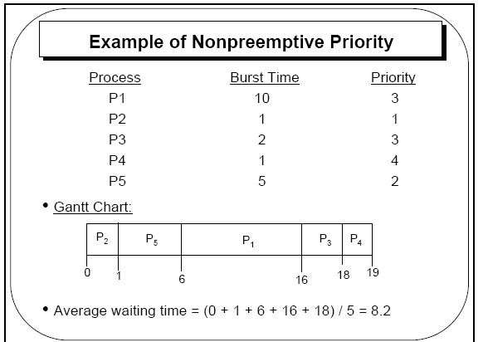
Operating System Concepts

Slide 38
Priority with Preemption?
Operating System Concepts

Slide 39

Round Robin (RR) Scheduling
FCFS Scheme: Potentially bad for short jobs!
  Depends on submit order
  If you are first in line at the supermarket with milk, you don’t care who is behind you; on the other hand…
Round Robin Scheme
  Each process gets a small unit of CPU time (time quantum)
    Usually 10-100 ms
  After quantum expires, the process is preempted and added to the end of the ready queue
  Suppose N processes in ready queue and time quantum is Q ms:
    Each process gets 1/N of the CPU time
    In chunks of at most Q ms
    What is the maximum wait time for each process?
Lec 3
Operating Systems

Slide 40
Round Robin (RR) Scheduling
FCFS Scheme: Potentially bad for short jobs!
  Depends on submit order
  If you are first in line at the supermarket with milk, you don’t care who is behind you; on the other hand…
Round Robin Scheme
  Each process gets a small unit of CPU time (time quantum)
    Usually 10-100 ms
  After quantum expires, the process is preempted and added to the end of the ready queue
  Suppose N processes in ready queue and time quantum is Q ms:
    Each process gets 1/N of the CPU time
    In chunks of at most Q ms
    What is the maximum wait time for each process?
      No process waits more than (n-1)q time units
Lec 3
Operating Systems

Slide 41

Round Robin (RR) Scheduling
Round Robin Scheme
  Each process gets a small unit of CPU time (time quantum)
    Usually 10-100 ms
  After quantum expires, the process is preempted and added to the end of the ready queue
  Suppose N processes in ready queue and time quantum is Q ms:
    Each process gets 1/N of the CPU time
    In chunks of at most Q ms
    What is the maximum wait time for each process?
      No process waits more than (n-1)q time units
Performance Depends on Size of Q
  Small Q => interleaved
  Large Q is like…
  Q must be large with respect to context switch time, otherwise overhead is too high (spending most of your time context switching!)
Lec 3
Operating Systems

Slide 42
Round Robin (RR) Scheduling
Round Robin Scheme
  Each process gets a small unit of CPU time (time quantum)
    Usually 10-100 ms
  After quantum expires, the process is preempted and added to the end of the ready queue
  Suppose N processes in ready queue and time quantum is Q ms:
    Each process gets 1/N of the CPU time
    In chunks of at most Q ms
    What is the maximum wait time for each process?
      No process waits more than (n-1)q time units
Performance Depends on Size of Q
  Small Q => interleaved
  Large Q is like FCFS
  Q must be large with respect to context switch time, otherwise overhead is too high (spending most of your time context switching!)
Lec 3
Operating Systems

Slide 43
Example of RR with Time Quantum = 4
Process Burst Time
P₁ 24
P₂ 3
P₃ 3
The Gantt chart is:
P₁
P₂
P₃
P₁
P₁
P₁
P₁
P₁
0
4
7
10
14
18
22
26
30
Lec 3
Operating Systems

Slide 44
Example of RR with Time Quantum = 4
Process Burst Time
P₁ 24
P₂ 3
P₃ 3
Waiting Time:
  P1: (10-4) = 6
  P2: (4-0) = 4
  P3: (7-0) = 7
Completion Time:
  P1: 30
  P2: 7
  P3: 10
Average Waiting Time: (6 + 4 + 7)/3= 5.67
Average Completion Time: (30+7+10)/3=15.67
P₁
P₂
P₃
P₁
P₁
P₁
P₁
P₁
0
4
7
10
14
18
22
26
30
Lec 3
Operating Systems

Slide 45
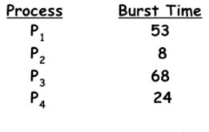
Example
Operating System Concepts

Slide 46
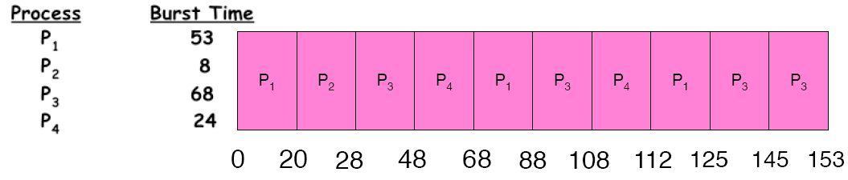
Example of RR with Time Quantum = 20
Waiting Time:
  P1: (68-20)+(112-88) = 72
  P2: (20-0) = 20
  P3: (28-0)+(88-48)+(125-108) = 85
  P4: (48-0)+(108-68) = 88
Completion Time:
  P1: 125
  P2: 28
  P3: 153
  P4: 112
Average Waiting Time: (72+20+85+88)/4 = 66.25
Average Completion Time: (125+28+153+112)/4 = 104.5
A process can finish before the time quantum expires, and release the CPU.
Lec 3
Operating Systems

Slide 47
RR Summary
Pros and Cons:
  Better for short jobs (+)
  Fair (+)
  Context-switching time adds up for long jobs (-)
    The previous examples assumed no additional time was needed for context switching – in reality, this would add to wait and completion time without actually progressing a process towards completion.
    Remember: the OS consumes resources, too!
If the chosen quantum is
  too large, response time suffers
  infinite, performance is the same as FIFO
  too small, throughput suffers and percentage overhead grows
    If there were 3 compilations going on, it took 3
    seconds to echo each keystroke!
  In practice, need to balance short-job
  performance and long-job throughput:
    Typical timeslice 10ms-100ms
    Typical context-switch overhead 0.1ms – 1ms (about 1%)
Lec 3
Operating Systems

Slide 48
Multilevel Queue
Ready queue is partitioned into separate queues:
foreground (interactive)
background (batch)
Each queue has its own scheduling algorithm,
foreground – RR
background – FCFS
Scheduling must be done between the queues.
  Fixed priority scheduling; (i.e., serve all from foreground then from background). Possibility of starvation.
  Time slice – each queue gets a certain amount of CPU time which it can schedule amongst its processes; i.e., 80% to foreground in RR
  20% to background in FCFS
Operating System Concepts

Slide 49

Multilevel Queue Scheduling
Operating System Concepts

Slide 50
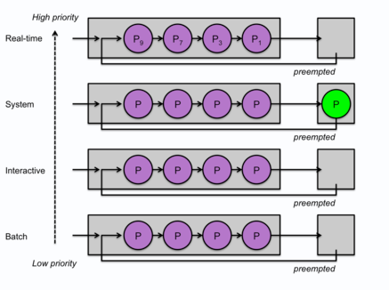
Multilevel Queue Scheduling
Operating System Concepts

Slide 51
Multilevel Feedback Queue
A process can move between the various queues;
Multilevel-feedback-queue scheduler defined by the following parameters:
  number of queues
  scheduling algorithms for each queue
  method used to determine when to upgrade a process
  method used to determine when to demote a process
  method used to determine which queue a process will enter when that process needs service
Operating System Concepts

Slide 52
Example of Multilevel Feedback Queue
Three queues:
  Q₀ – time quantum 8 milliseconds
  Q₁ – time quantum 16 milliseconds
  Q₂ – FCFS
Scheduling
  A new job enters queue Q₀ which is served FCFS. When it gains CPU, job receives 8 milliseconds. If it does not finish in 8 milliseconds, job is moved to queue Q₁.
  At Q₁ job is again served FCFS and receives 16 additional milliseconds. If it still does not complete, it is preempted and moved to queue Q₂.
Operating System Concepts

Slide 53

Multilevel Feedback Queues
Operating System Concepts

Slide 54
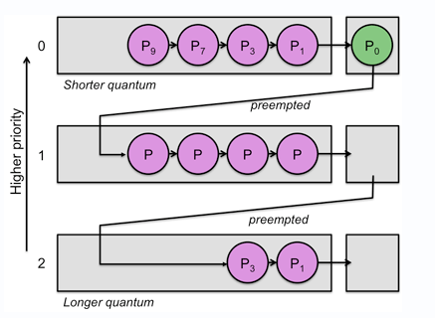
Operating System Concepts

Slide 55
Guaranteed scheduling
attempts to be fair to the users, not the processes.
if n users are logged in, it will try to give each user (not process) 1/n of the CPU time.
What the scheduler does is keep track of how much CPU time a user has had for all processes since login and how long the user has been logged in. It then computes the user's share of the CPU as:
User's share of CPU = (time since login / n)
The scheduler compares that (the actual) to the ideal (computed) share and picks the process with the lowest ratio. As it continues to be scheduled, its the actual:ideal ratio will increase and eventually move ahead of its nearest competitor, causing the next process to get scheduling priority.
Operating System Concepts

Slide 56
Example
Another form of guaranteed scheduling is to assign groups of users into a several classes and give each class a predefined share of the CPU.
For example, suppose three departments jointly own a computer.
They may set up the scheduler such that any processes from users in department A will get no more than 20% of the CPU, users in department B will get no more than 50% and users in department C will get no more than 30% of the CPU time.
A similar mechanism was used under VM (IBM's virtual machine system) in which each operating system running under VM would be guaranteed a certain percentage of the CPU — no more and no less.
Operating System Concepts

Slide 57
Advantage: Disadvantage
Advantage: Guaranteed scheduling is fair to the user. It penalizes those users who wish to run many processes and favors those who run only a few. The shares of CPU time are allocated by the administrator and fit well with other bureaucratic processes, such as the purchase and upkeep of the computer.
Disadvantage: Guaranteed scheduling requires quite a bit of bookkeeping. While it's fair to the user, it's not fair to processes or the CPU. A user that is getting a large share of the CPU may never need it, but will get it anyway. Meanwhile, other processes may be hungry to use the CPU.
Operating System Concepts

Slide 58
Multiple-Processor Scheduling
Processor affinity - The scheduler keeps track of what processor the process ran on previously and attempts to reschedule the process onto that same processor.
There are two forms of processor affinity.
Hard affinity ensures that a process always gets scheduled onto the same processor.
Soft affinity is a best-effort approach. A scheduler will attempt to schedule a process onto the same CPU but in some cases may move the process onto a different processor. The reason for doing this is that, even though there may be an initial performance penalty to start a process on another CPU, it's probably better than having the CPU sit idle with no process to run..
Operating System Concepts

Slide 59
Load Balance
The scheduler tries to load balance the CPUs to make sure that they have sufficient tasks in their run queue.
There are two approaches to load balancing among processors:
Push migration is where the operating system checks the load (number of processes in the run queue) on each processor periodically. If there's an imbalance, some processes will be moved from one processor onto another.
Pull migration is where a scheduler finds that there are no more processes in the run queue for the processor. In this case, it raids another processor's run queue and transfers a process onto its own queue so it will have something to run.
Operating System Concepts

